Slide 1
Coupling and Cohesion
Week 2-2
Notes:
Welcome to a short reading about “coupling and cohesion.”
These are key topics, which all developers talk about. And worry about. They are really “issues” about design, more than they are “concepts.”
The reason is that, by handling these well, you can save everyone a lot of work!
If you handle them badly, it’s the reverse.
The goal of this set of “reading slides” is for you to see the main points, as a slide, and also see the details, in these notes below.
So, you can go at your own pace, look at the main points, if you “get it” just from those, or delve into these details if you want to see more.
Or, start with the big view, then explore those details.
We’ll talk in class about how that went! Good luck, and have fun…
There are only 27 slides to look at, by the way!

Slide 2
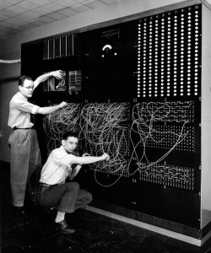
Coupling or Dependency
Coupling is the degree to which a software component relies on other software components to achieve its purpose
Does your code look like this?
Is this easy to change?

Slide 3

Cohesion
Cohesion refers to the degree to which elements of a software component belong together
Notes:
Cohesion is this wonderful design feature, where everything you could imagine, that’s close to A, is a part of A.
And anything that feels out of place, as a part of A, isn’t.
SRP pretty much sums this up. You can say concisely what A does. And you don’t have to explain a bunch of extra details which feel as if they don’t belong in A.
It’s “putting things together which feel like they go together,” to the designer and to the developers who use their design.
Now, of course, this is a perspective, an opinion. It somehow relates to issues like, “What turns out to look like a sidetrack when we get into coding?”
How did we run into this with the ducks in Ch 1? Well, in the designer’s first release, it seemed ok to put quacks and flying behavior right into the individual duck subclasses. Later on, these got to be big and messy enough, that they looked like one of those “sidetracks.” Just “being a duck” of a certain kind, with hints about its behavior, was enough for a duck subclass. We made separate families of classes for quacking and flying.
We modified our design to maintain a clear feeling of “cohesion.”
With just a taste of the “Single Responsibility Principle” (SRP)

Slide 4
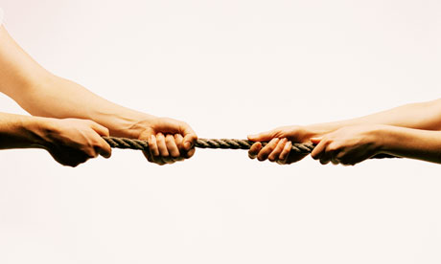
The Classic SE Problem
You cannot have “no coupling” and total cohesion at the same time
A good design is all about maintaining the right balance
Notes:
If you have no coupling (good), you have no cohesion (bad).
If you have high cohesion (good), you have high coupling (bad).

Slide 5
Today
Coupling
Principle of Least Knowledge: how to couple code well
PLK in Strategy and Observer
Cohesion
Single Responsibility Principle: how to design cohesive classes

Slide 6
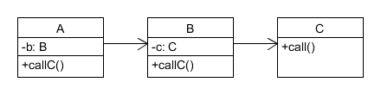
Principle of Least Knowledge (PLK)
If A is friends with B, then A asks B for services.
A never asks strangers (like C) for services.
Analogy: asking a friend to use their cell phone to call one of their friends.
How it should work…
Notes:
There are several ways to put this “law”:
Each unit should have only limited knowledge about other units: only units "closely" related to the current unit know much about it. Or,
Each unit should only talk to its friends; don't talk to strangers. Or,
Only talk to your immediate friends. Or,
Only use one dot in a method call.
“When one wants a dog to walk, one does not command the dog's legs to walk directly; instead one commands the dog which then commands its own legs.”
Why is this a big advantage?
B is not so tightly coupled to either A or C. It doesn’t have to remember or care exactly how A uses C.
Summary: Don’t make messy, interwoven relationships among classes.
Especially, classes that someone else, later on, might not expect to be dependent on each other.
See https://en.wikipedia.org/wiki/Law_of_Demeter.

Slide 7
PLK – in code
If A is friends with B, then A asks B for services.
A never asks strangers (like C) for services.
public class A {
B b = new B();
public void callC() {
b.callC();
}
public static void main(String… args) {
new A().callC();
}
}
public class B {
private C c = new C();
public void callC(){
c.call();
}
public C getC(){
return c;
}
}

Slide 8
Principle of Least Knowledge
Only call methods on:
this
The fields of this
Your method’s parameters
Anything your method creates with new

Slide 9
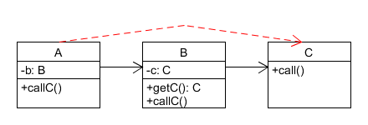
Trainwrecks – opposite of PLK
When A reaches into B’s personal space to access C.
Analogy: grabbing a friend’s cell phone out of their hand to call one of their friends.
Notes:
Invading personal space violates the Law of Demeter.

Slide 10
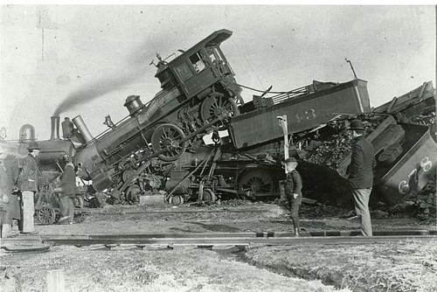
Trainwrecks – in code
Calls on nonlocal data appear to “pile up.”
Examples:
b.c.call();
b.getC().call();
C c = b.getC(); c.call();
https://www.ambassadorsolutions.com/main-blog/its-train-wreck-tuesday/
Notes:
Each of the three examples is a trainwreck. Furthermore, they are all equivalent code. Convince yourself 2 and 3 are exactly the same code.
Slapping a letter “c” bumper sticker on a wrecked train car does not make the situation any less of a trainwreck.
The name trainwreck invokes the image of “piling on” a long string of method calls on returned values, like these.

Slide 11
The root of the problem
If B encapsulates its instance of C, then B should not share C with strangers!
public class B{
private C c = new C();
public void callC(){
c.call();
}
public C getC(){
return c;
}
}

Slide 12
Should we provide getters?
In general: no.
Objects perform actions but hide their implementation details.
Public fields are just as bad.
Exception: data structures are not objects.
Reveal their data but do nothing with it.
PLK doesn’t apply to data structure access.
Beware hybrid object/data structures.
b.getC().call();
b.c.call();
Notes:
Objects hide data to compute something with it.
Getters expose data.
Getters invite trainwrecks.
Data structures expose data, but do not compute anything with it.
Data structures can have getters.
Do not add getters just because you can. Think carefully about the purpose of suppling the getter and refactor into an object/data structure split as needed.

Slide 13
PLK restated
Only call methods on these objects:
this
The fields of this
Your method’s parameters
Anything your method creates with new
Corollary: don’t write trainwrecks
A trainwreck occurs when you call a returned value’s methods.
Notes:
We clarify PLK to only apply to objects, not data structures.
Trainwrecks offer an easier way to think about PLK depending on the context.

Slide 14
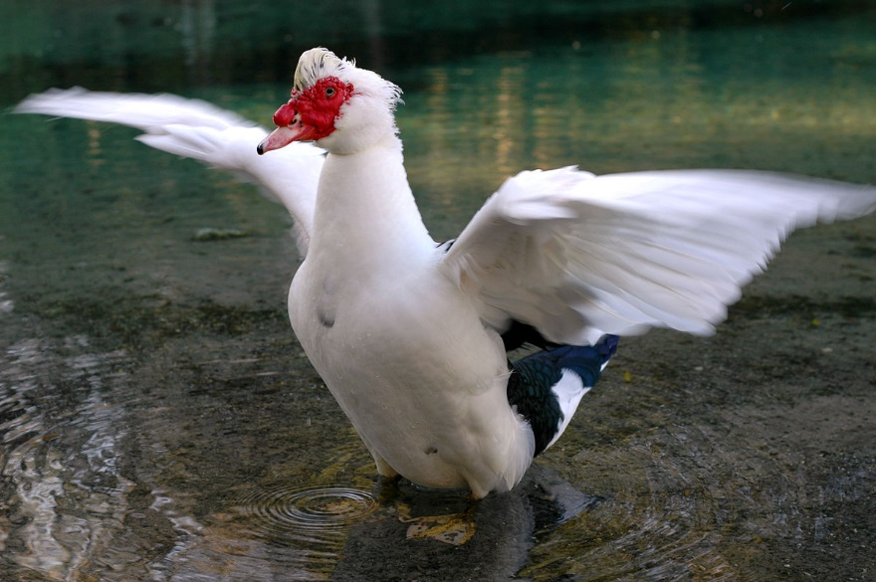
PLK in the “Strategy” pattern
Objects should protect access to their Strategies.
DuckSim calls myDuck.fly()
Not myDuck.getFlyBehavior().fly()
Hands off my FlyBehavior!
A duck observed in the wild protecting its Strategy.
Notes:
Again, what’s “close” is likely to be:
Some other class wanting to use a certain “duck”, and
That subclass of “duck”.
In order to make that duck “quack”, the other class doesn’t need to manipulate code that really quacks.
Just the standard method, in that particular duck, which knows how it quacks.
This is also an example of OO encapsulation generally.
The less you have to know about how something works, the easier it is to implement it.
Or change it later on.
https://en.wiktionary.org/wiki/duck

Slide 15
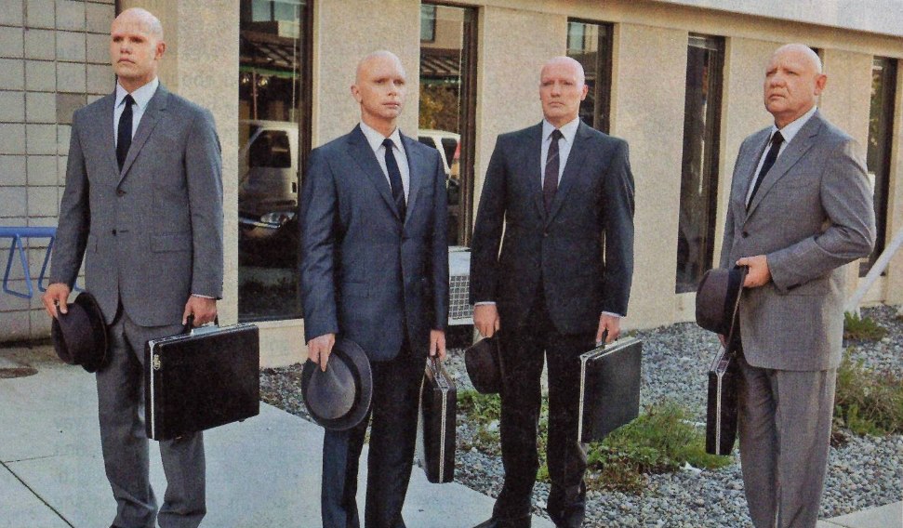
PLK in the “Observer” pattern
The Subject does not:
Know who the Observers really are.
Access the Observer’s concrete fields/methods.
The Subject only calls the Observer interface’s “update” method.
No one knows who the Observers are.
They all look alike.
Avoid their personal space.
Notes:
Indeed, each Observer just “registers” with the Subject, to get what a particular kind of update, or all updates.
Then when something happens, they can be made aware (by a push or pull of the data).
http://www.tvovermind.com/wp-content/uploads/2009/11/Observers.PNG

Slide 16
Check your understanding
See the 2-2 In-Class Trainwreck Quiz on Moodle
Which of the examples given are trainwrecks?
How would you rewrite them?

Slide 17
Other Anti-patterns

Slide 18
Common Coupling
Global variables shared between modules
class GameState {
public static int score;
}
class GameEngine {
public void addScore(int score) {
GameState.score += score;
}
}
class Player {
public void resetScore() {
GameState.score = 0;
}
}
Notes:
Q: Under what circumstances would this coupling pose a problem?
A: if we need to change the way the score works later on. Separate what could change from what stays the same.
This type of coupling gets its name because “Common data” is another name for “Global data.”
Q: When might it be more OK to have shared global data?
A: When it’s “final” – doesn’t change.
A: When only one class can change it. But, to guarantee that, shouldn’t we have used a different design? Like, make “score” a part of the class which can change it?

Slide 19
External Coupling
// <<external_software>>
class Serializer {
public static byte[] serialize(String s) {
byte[] ser = s.getBytes();
for(int i = 0; i < ser.length; ++i) {
ser[i] = (byte)(ser[i] & 0x1F00);
}
return ser;
}
}
Share an externally imposed data format or communication protocol
class Player {
String name;
public void save() throws Exception {
byte[] ser = name.getBytes();
for(int i = 0; i < ser.length; ++i) {
ser[i] = (byte)(ser[i] & 0x1F00);
}
FileOutputStream f = new FileOutputStream("player.dat");
f.write(ser);
f.close();
}
}
Notes:
The worst case here? When the classes sharing the external device or format have to synchronize what they do, somehow.
The base case? It’s just a format or interface, and we have to be sure to change it in two different places when it does change.
Prefer to use a shared library of serializable data transfer objects to describe data. Use a common serialization framework (like Java’s “object streams”, “jackson”, etc) instead of writing your own serialization.

Slide 20
Cohesion
Do a set of methods belong together?

Slide 21
What is this class’s job?
public class Utilities
Notes:
“Utilities” is the dumping ground of all poorly designed code.

Slide 22
What is this class’s job?
public class SaveButton
extends JButton
implements ActionListener
{
public SaveButton(){
super(“Save”);
this.addActionListener(this);
}
…
Notes:
Both the button and the thing that handles the save action.

Slide 23
What is this class’s job?
public class Main
extends ActionEvent
implements Iterator<Main>, Throwable, Executor, Runnable, ActionListener
{
public Main next() {
if(!this.hasNext()) {
throw this;
}
this.execute(this);
this.actionPerformed(this);
return this;
}
Notes:
Essentially one job per interface.

Slide 24
Single Responsibility Principle (SRP)
Naïve definition: a class should do one thing.
Actual definition: a class should have one reason to change.

Slide 25
How many reasons to change does MouseListener impose?
public interface MouseListener
extends EventListener {
public void mouseClicked(MouseEvent e);
public void mousePressed(MouseEvent e);
public void mouseReleased(MouseEvent e);
public void mouseEntered(MouseEvent e);
public void mouseExited(MouseEvent e);
}
How might you redesign MouseListener to reduce the responsibilities?
What design tradeoff do you introduce?
Notes:
What’s bad about Swing’s Mouse Listener? You probably have your own ideas.
I always hated having to generate code for things you weren’t going to use. Like maybe all you care about is mouseClicked?
Even if Eclipse generated this stuff for you automatically, when you went back to do maintenance on the code, you had to look, to see if any of those other methods were used!
There are 5+ responsibilities: five loosely methods + the methods of EventListener (which hilariously is an empty interface).
If you refactor the interface sensibly to one mouse interface per event type, the issue you run into is now you have all of these very similar interfaces.
Congratulations! You gained cohesion at the cost of creating more coupling. You are now a certified SE.

Slide 26
The Classic SE Problem
Increased cohesion (good) leads to increased coupling (bad).
Decreased coupling (good) leads to decreased cohesion (bad).

Slide 27
... but the tradeoffs are constrained
Violating the Principle of Least Knowledge is always bad.
Increases coupling (bad).
Decreases cohesion (bad).
Violating the Single Responsibility Principle to decrease coupling is generally bad.
Strive to be better than the Java 1.1 developers.
Notes:
PLK does not negotiate with students.
There are some lines you must not cross.

Slide 28
Lab exercise 2-2
Import Lab Exercise 2-2 into Eclipse as a Gradle project

Slide 29
Activity – Part 1 [20m]
You are given code that implements a business process for handling car insurance claims.
The code mostly works, but contains trainwrecks that have enabled shady business dealings to creep into the code.
Work with a partner to:
Identify all trainwrecks present in the code.
Draw the PlantUML class diagram for this code.
Color the edges that cause the trainwrecks red in the diagram.
Ask your instructor to check your work.

Slide 30
Activity – Part 2
Revise your diagram to remove the trainwrecks.
The new design must remain functional.
Hide data that should be hidden.
Give objects intelligent behavior that act on the hidden data.
Remove the red edges to the now-hidden data.
Refactor the code to match the new diagram.
Check-off with instructor: prove that the trainwrecks are gone and that the code still functions.

